Slide 1
SQA Solar
Stuart Winning
30th September 2017

Slide 2
What is SOLAR?
SOLAR is SQA’s e-assessment system which is used to deliver assessments on many devices including tablets and iPads.
These e-assessments are secure, quality assured, pre-verified and both summative and formative. These are available to all SQA approved centres.

Slide 3
Why use SOLAR?
System is free to all SQA approved centres
Browser based software allows access anywhere to manage assessment delivery.
A range of secure delivery options, including offline.
Pre-verified questions are randomly generated from an Itembank to provide quality assured assessments.

Slide 4
Why use SOLAR?
Supports a variety of question types.
Automatic marking and results available on completion.
Comprehensive reporting and analysis.
Formative content available 24/7 from our OpenAssess software.
Availability of instant feedback to learners on result and review of completed assessments.
App delivery available from Apple and Google Play (because website uses Flash you will need to use a browser like Puffin).

Slide 5
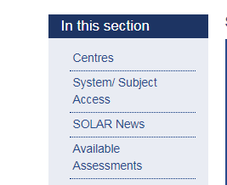
How to get access?
Any SQA approved centre can get access to current assessments for subjects that they are delivering. Simply check whether you already have valid users who can create your account and request new subject access, or if you are not a current SOLAR centre you can request access to the system. This can be done through our ‘System/Subject Access' section, which is located under the ’Centres’ Tab.
Once a member of staff is registered they can then add further members of staff onto the system.

Slide 6
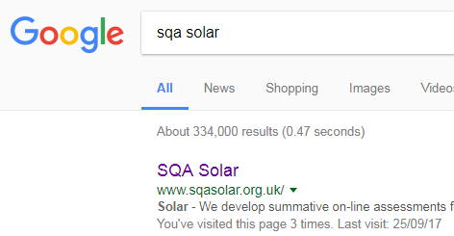
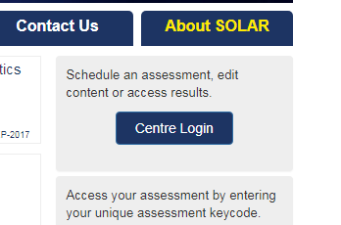
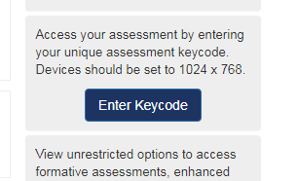
Finding SOLAR
Just use Google to search for ‘SQA SOLAR’
From here teachers can click on ‘CENTRE LOGIN’
Pupils would click on ‘ENTER KEYCODE’ to start an assessment

Slide 7
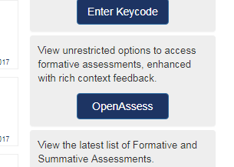
Using OpenAssess
If you want to prepare for an assessment, or if you want the pupils to become more familiar with the layout of SOLAR, then you can click on OpenAssess. These questions can be accessed and answered without a keycode.

Slide 8
What can SOLAR be used for in Mathematics?
All 3 unit assessments of the Applications of Mathematics courses (Nat 3 to Nat 5 – including Numeracy)
National 4 Numeracy
Lifeskills Mathematics National 2 Units

Slide 9
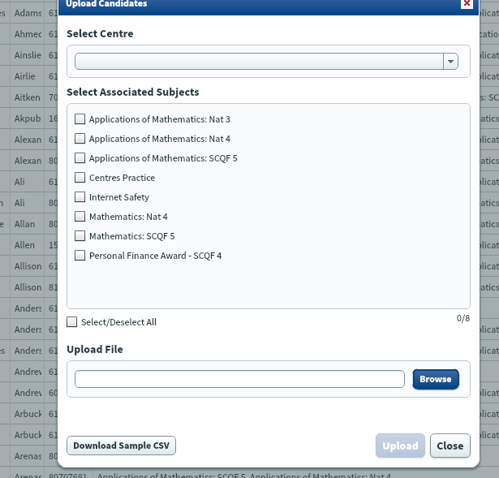
Adding Pupil Information to SOLAR
When you login if you click on the ‘CANDIDATES’ tab you can click on ‘UPLOAD CANDIDATES’ to upload pupil information.
I would recommend that you collect a spreadsheet of pupil information from your school office as this is a quick way to upload large groups of pupils.

Slide 10
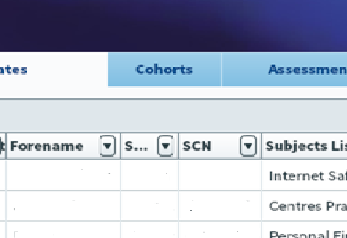
Creating Classes/Cohorts
Once pupil information has been added to SOLAR you can click on the ‘COHORTS’ tab to place pupils into classes.

Slide 11
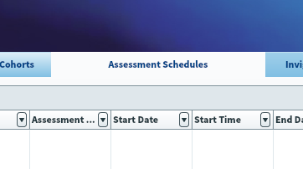
Creating An Assessment
To create an assessment click the ‘ASSESSMENT SCHEDULES’ tab and then click ‘CREATE ASSESSMENT’ at the bottom of the page.
From here follow the onscreen instructions to create the assessment.
I would advice choosing more than one day of the assessment. This allows you to pause and resume assessments from the ‘Invigilation’ tab.

Slide 12
Lets look at a Numeracy assessment created on SOLAR
National 5 Numeracy (can be booked as one outcome or by assessment standard)

Slide 13
Other Notes
Manually marked questions
Results tab (including using ‘CANDIDATE BREAKDOWN’ to find out which parts were failed in order to organise resits.

Slide 14
The Good, The Bad and The Ugly: My experiences of using SOLAR
Numeracy Units on Solar
Different Questions for each pupil
Pupil Experiences

Slide 15
The Good, The Bad and The Ugly: My experiences of using SOLAR
ICT access
Flash
Not available for other National 4 or 5 units

Slide 16
The Good, The Bad and The Ugly: My experiences of using SOLAR
On screen tools and interface issues
Limited question bank (but hopefully not for long)
Occasional glitches – but pupil answers are available to view

Slide 17
Questions

